Slide 1

Project 1
2017 – Advanced Programming
June 17, 2017
Kamalova Albina
Robotics & Control System Lab.
Dept. Electrical Eng., Yeungnam University, Korea
(Tel. 010-9921-6172, E-mail: dyupleks@gmail.com)

Slide 2
Agenda
Wiring to Raspberry Pi 3
1.1 MCP3208
1.2 Photo-resistor
1.3 LED
2. Programming
3. Python GUI control

Slide 3
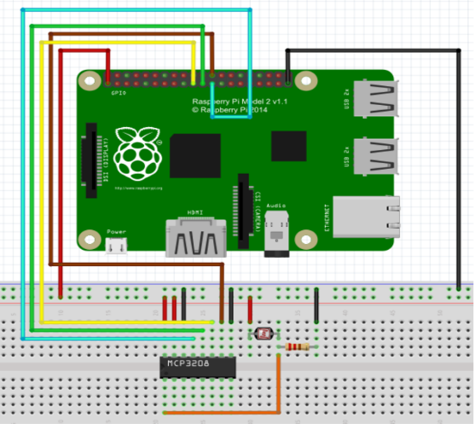
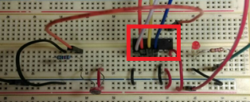

MCP3208 to Raspberry Pi 3
As Raspberry Pi can not handle analog inputs, It was necessary an ADC adapter for converting analog voltage into digital signal.
For that, I wired the Raspberry Pi 3 with MCP3208 ADC converter following this circuit connection graph Fig 1 [1]. Some others resources were also learned such as [2] and [3].
Related to MCP3208’s and Pi’s pins, it was connected in this accordance:
Fig 1
MCP3208 VDD -> 5V (pin 2)
MCP3208 VREF -> 5V (pin 2)
MCP3208 AGND -> GND (pin 39)
MCP3208 CLK -> GPIO11 SPIO_SCLK (pin 23)
MCP3208 DOUT -> GPIO09 SPIO_MISO (pin 21)
MCP3208 DIN -> GPIO10 SPIO_MOSI (pin 19)
MCP3208 CS -> GPIO08 SPIO_CEO_N (pin 24)
MCP3208 DGND -> GND (pin 39)
Fig 2

Slide 4
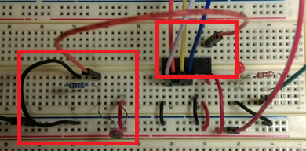

Photo-resistor to MCP3208
The photo-resistor (1kOhm) and resistor (10kOhm) were jointed to the MCP3208’s analog input.
The photo-resistor’s resistance varies depending on the amount of light falling on it.
The “resistive” sensors can be used with a Raspberry Pi by timing how long it takes for current to flow through the resistive sensor.

Slide 5
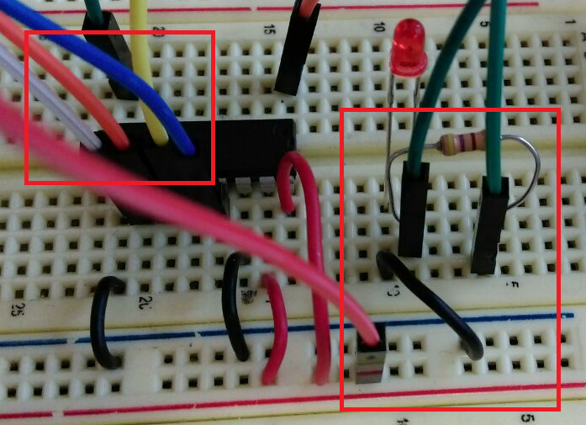
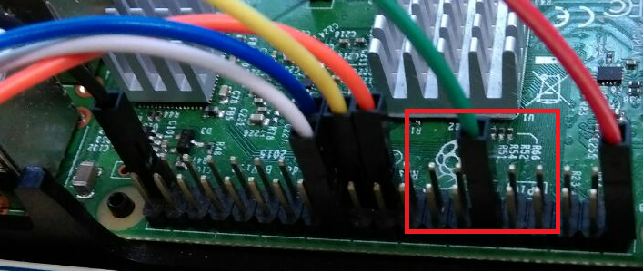
LED to MCP3208
The red LED and resistor (470 Om) were connected to MCP3208’s channel 7

Slide 6
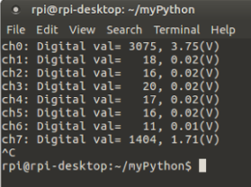
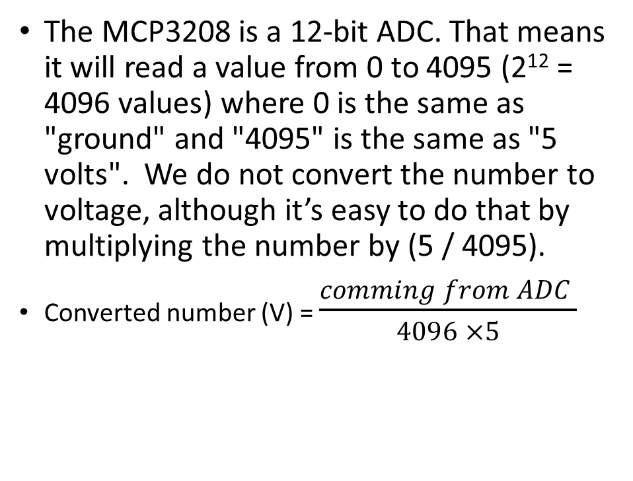
Programming
The MCP3208 is a 12-bit ADC. That means it will read a value from 0 to 4095 (2¹² = 4096 values) where 0 is the same as "ground" and "4095" is the same as "5 volts". We do not convert the number to voltage, although it’s easy to do that by multiplying the number by (5 / 4095).
Converted number (V) = $\frac{comming from ADC }{4096 ×5}$

Slide 7
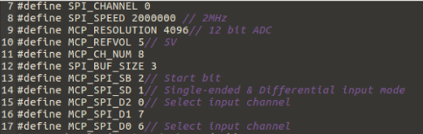
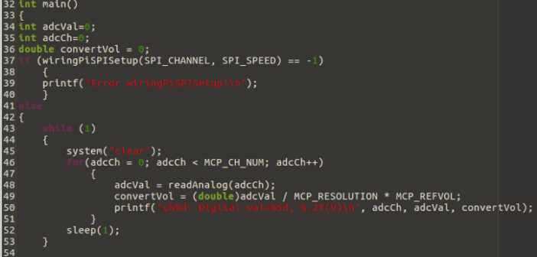
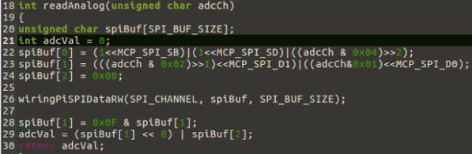
Programming
Initialization
Main function: int_main
Reading analog data function: readAnalog

Slide 8
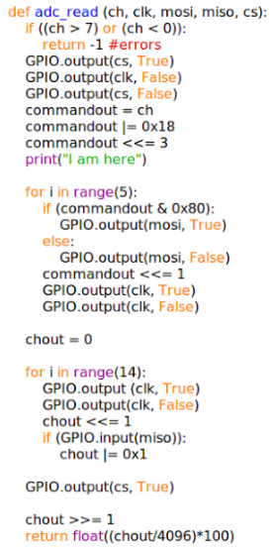
Python GUI Control
Program “brightness.py” structure:
Import RPI, tkinter, time libraries
Pins setup and initialization
__init__ function for creating tk widgets (objects): Label, Radiobutton, Button, Scale
Callback functions from widgets commands: updateA(), updateM(), scaleAct(), adc_read()

Slide 9
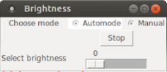
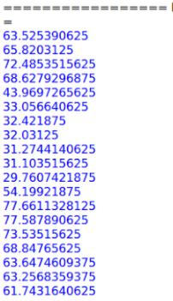
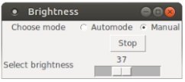
Python GUI Control
Automate:
Manual:

Slide 10
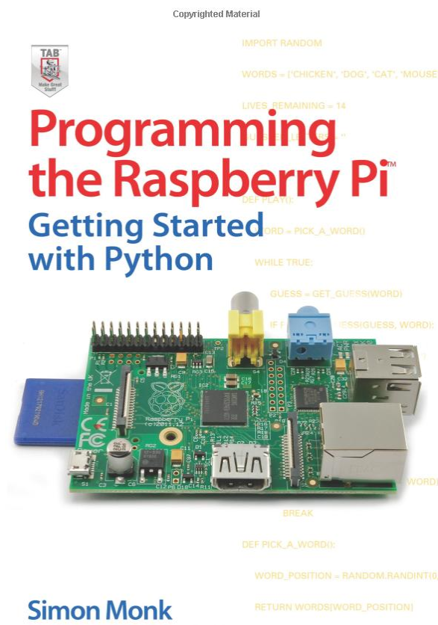
References
[1] http://osoyoo.com/2016/12/16/raspberrypi-photoresistor/
[2] http://www.icbanq.com/PBLOGER/BOARD_VIEW.ASPX?number=269
[3] https://pimylifeup.com/raspberry-pi-adc/
[4] http://www.python-course.eu/tkinter_sliders.php
[5] https://learn.adafruit.com/raspberry-pi-analog-to-digital-converters/mcp3008
[6] http://www.tkdocs.com/tutorial/firstexample.html and etc.
[7]

Slide 11
지금까지 발표를 들어 주셔서 감사합니다

